Slide 1
How to access Google Classroom.

Slide 2
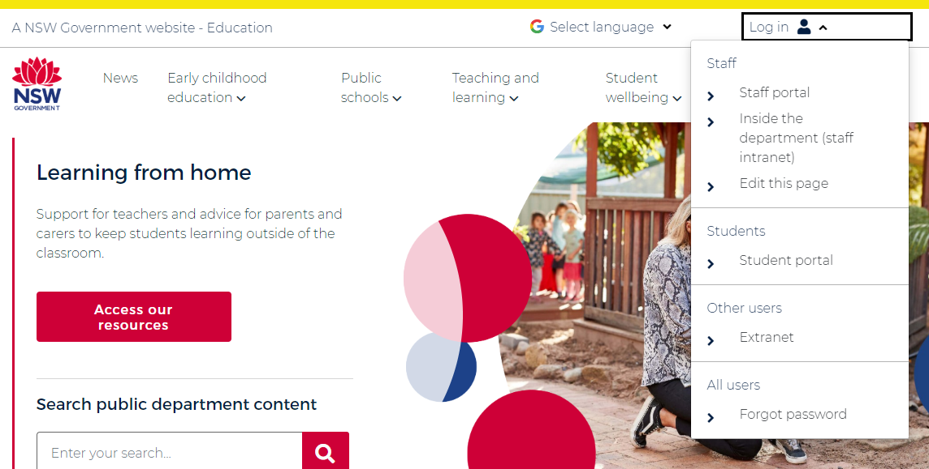
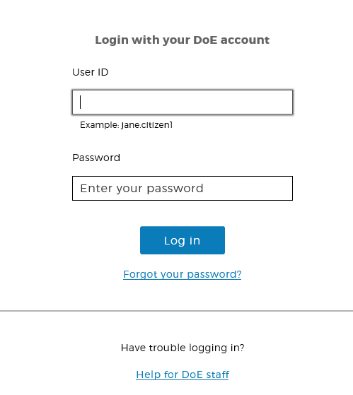
Follow the instructions to access Google Classroom via the school website and student portal.
Step 1: Go to the school website https://education.nsw.gov.au/
Step 2: Click on student portal
Step 3: Type in username and password that has been provided. Login.

Slide 3
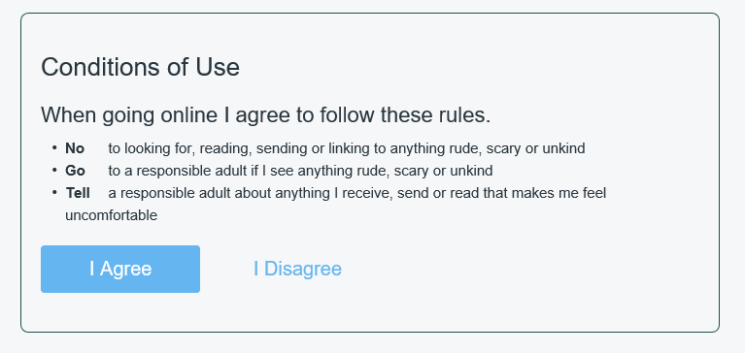
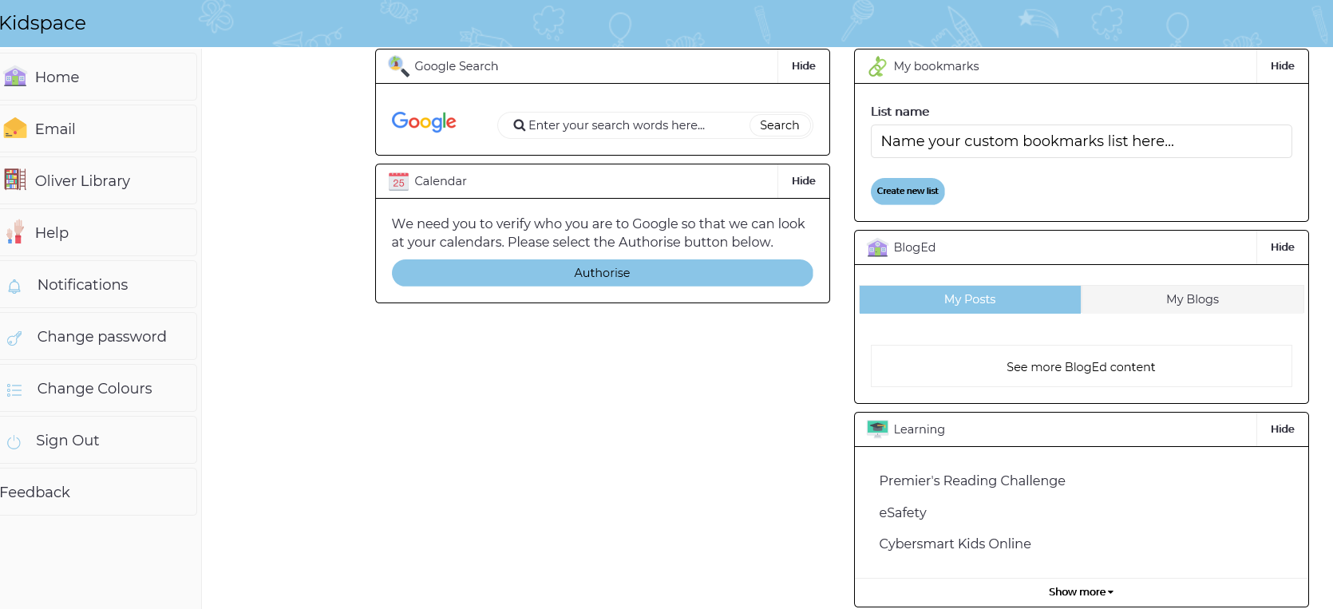
Step 4: Click on ‘I agree’ to Conditions of Use.
Please note: if your child has logged in before this may not appear.
Step 5: Go the ‘Learning’ box
Step 6: Click on ‘show more’.

Slide 4
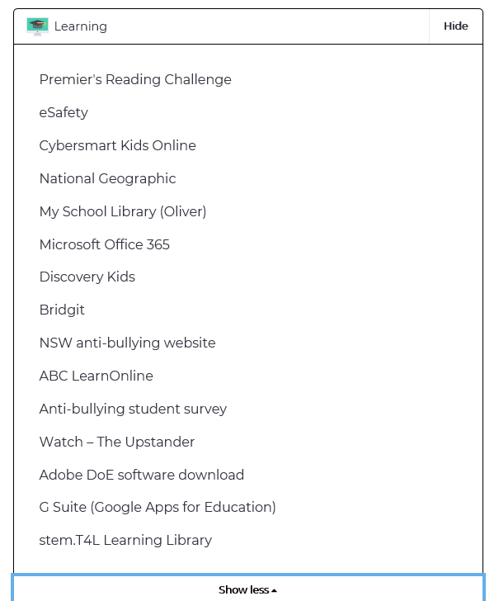
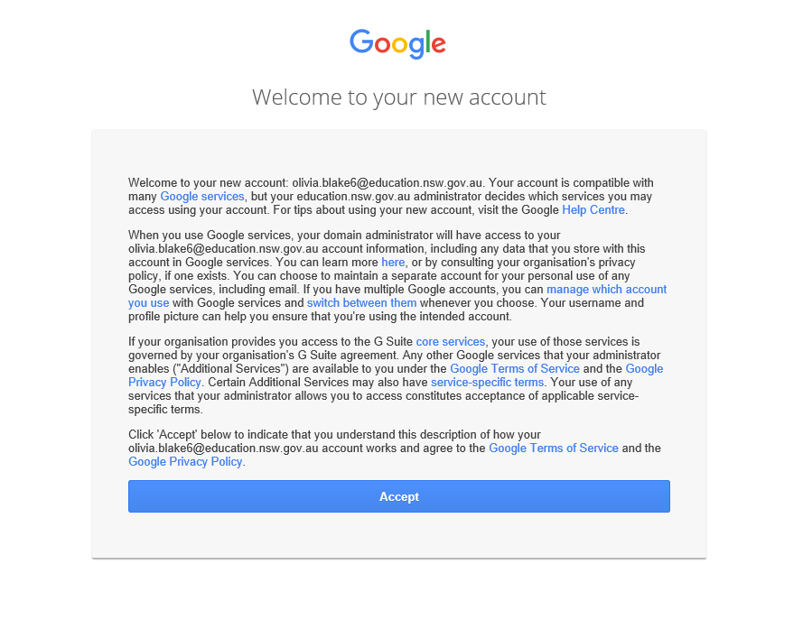
Step 7: Click on G Suite (Google Apps for Education)
Step 8: Click on ‘Accept’
Please note: if your child has logged in before this will not appear.

Slide 5
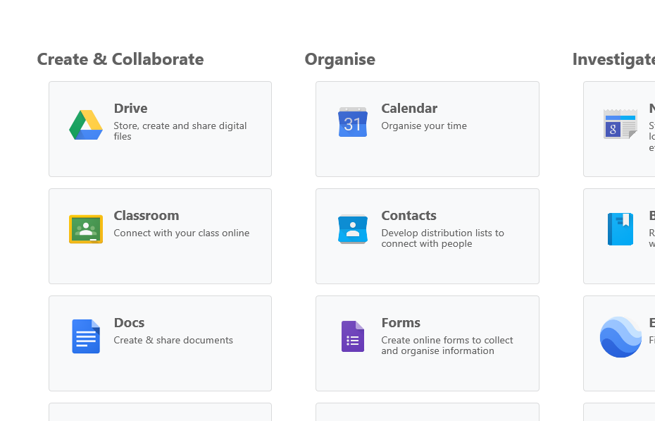
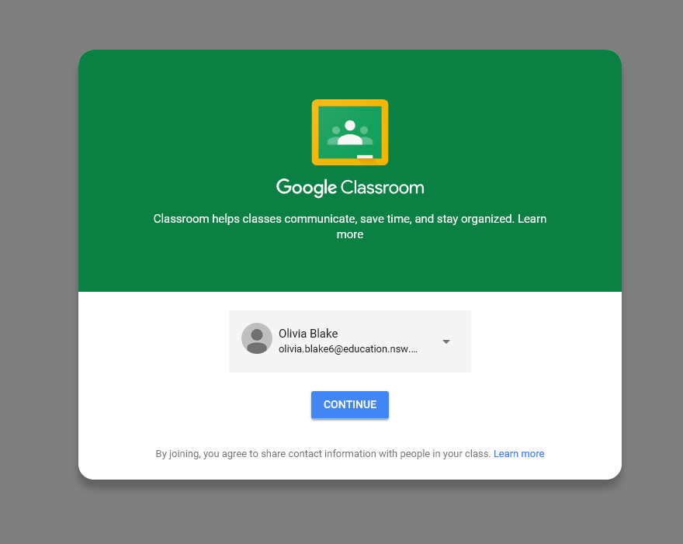
Step 9: Click on ‘Classroom’.
Step 10: Click on ‘Continue’.
Please note: if your child has logged in before this will not appear.

Slide 6
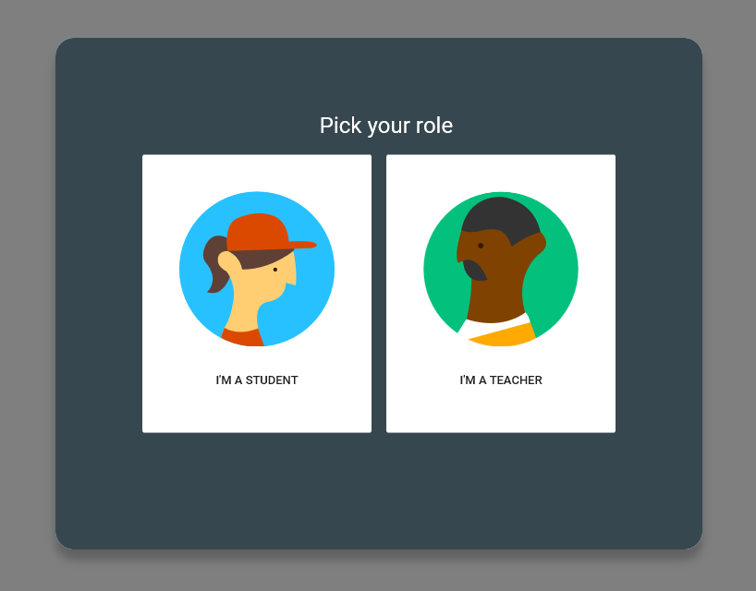
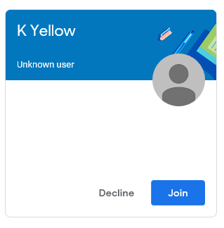
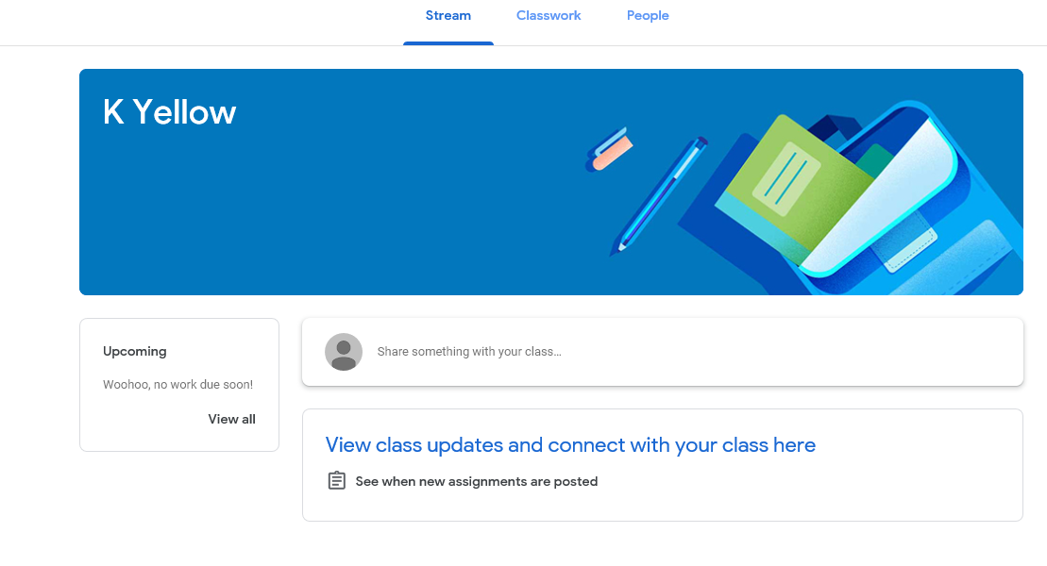
Step 11: Click on ‘I’m a student’.
Please note: if your child has logged in before this will not appear.
Step 12: Click on ‘Join’. If you have joined previously, simply click in the box.
You will now be in your stream and see your class posts.

